Slide 1
Thermal Temp. Sensor
Peter Mohr: Project Manager, CS
Shaima Hussien: Team Lead, CE
Adrian Schrage: Scribe, EE
Lexi Winkle: Timekeeper, EE

Slide 2
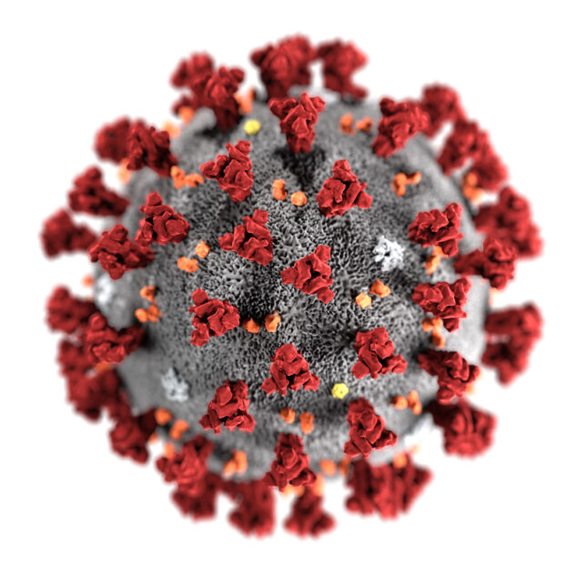
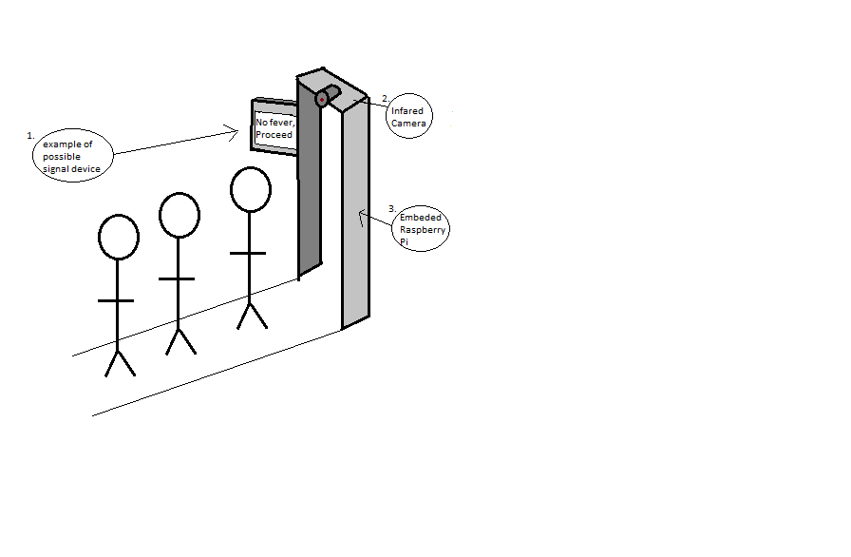
Thermal Temp. Sens.-Adrian
Product
Features
Importance
Covid-19/High Fever
At Risk Population
Government. (2021, October). Covid-19 Nursing Home Data. Data.Cms.Gov. https://data.cms.gov/covid-19/covid-19-nursing-home-data
Why Ours?
Cost
Olson, Marissa. How Much Does An Automated Temperature Scanner Cost?. Aug. 2020, https://www.ais-now.com/blog/automated-temperature-scanner-cost
User Friendly

Slide 3

Emberhope Youthville -Adrian
Potential testing partner
Residential Campus & Secure Care
Access to girls ages 6-18 as well as staff 24/7
Typically, 50 kids and 10 staff are at the school
In residential campus typically 10 kids and 3 staff
Sponsor: Lori Gonzales (VP, CPO)
Shirley, Brian. “Residential.” EmberHope Youthville, https://www.emberhope.org/how-we-help-foster-care-adoption-counseling-residential-emberhope-programs/residential/. Accessed 8 Oct. 2021.

Slide 4
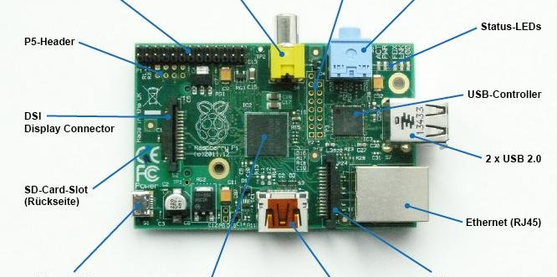
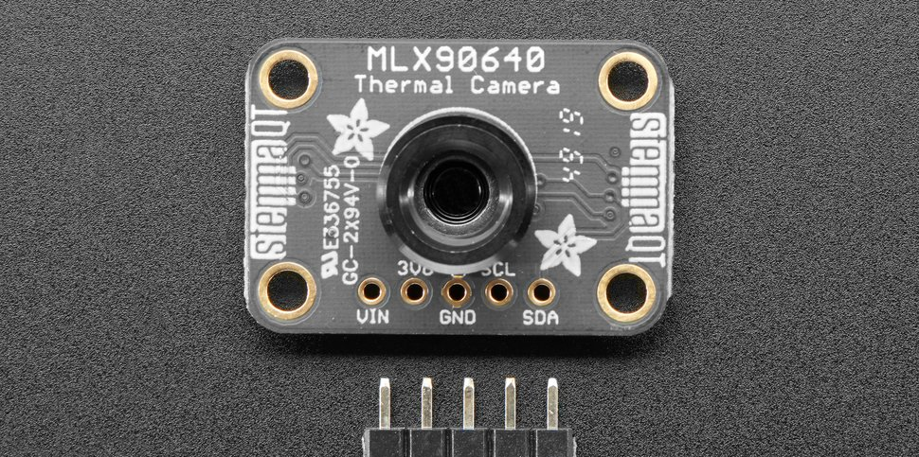
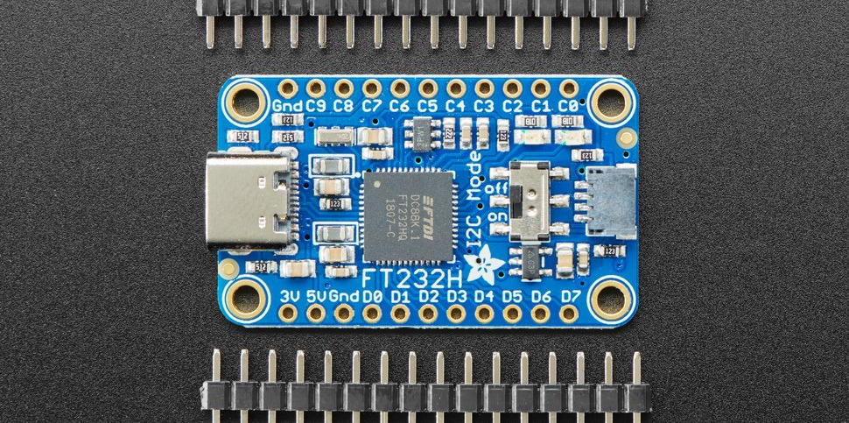
Components of the design: -Shaima
Infrared Thermal Camera Adafruit MLX90640
QT Raspberry Pi
FT232H USB C to QT PCB
LED array or LCD display
QT connectors

Slide 5

Integration of Components

Slide 6
What is needed -Peter
Temperatures need to be taken quickly and reliably
The end user needs simple, clear direction concerning their temperature

Slide 7
How to Do it -Peter
First, the thermal imaging camera will provide, bulk, real-time temperature data that will be sent to a Raspberry Pi
Software on the Raspberry Pi will analyze the temperature data and determine if the image in frame contains someone with a fever
The Raspberry Pi will indicate on either a string of LEDs or a small display if they should STOP because they have a fever, PROCEED if they do not have a fever, or WAIT if the imager is unable to tell if they have a fever.

Slide 8
Reliable Thermal imaging -Peter
The MLX90640 camera has been released for several years and has code libraries already developed and implemented.
The FT232H USB C to Stemma QT connector allows for plug and play operation and simple testing
Troubleshooting and operational difficulties have already been explored by others and extensive documentation is online

Slide 9
Raspberry PI -Peter
The Raspberry PI runs a Linux operating system and can already utilize the python libraries necessary to effectively to communicate with MLX90640 thermal imaging camera
The platform also has General Input Output PINs allowing for direct communication with a signaling device (Either arrayed LEDs or a small display)

Slide 10
Ethical and Legal Concerns

Slide 11
Ethical Research -Lexi
Inaccurate body temperature measurements
Appropriate locations
FDA (Food and Drug Administration)
Safety Recommendations
Measure one person at a time
Allow skin to adjust back to normal temperature
Keep camera away from strong light sources, mirrors, or other shiny surfaces
Health, Center for Devices and Radiological. “Improper Use of Thermal Imaging Devices: FDA Safety Communication.” FDA, Mar. 2021. www.fda.gov, https://www.fda.gov/medical-devices/safety-communications/improper-use-thermal-imaging-devices-fda-safety-communication.

Slide 12
Legal Research -Lexi
LETA (Law Enforcement Thermographers' Association)
Must have camera certified if using in a law enforcement environment
LETA Standards and Protocol. https://www.leta.org/standards-protocol.htm. Accessed 5 Oct. 2021.
ACLU (American Civil Liberties Union)
Privacy Issues
Individual records
Collection of temperatures
Stanley, Jay. Temperature Screening and Civil Liberties During an Epidemic. 19 May 2020, https://www.aclu.org/sites/default/files/field_document/aclu_white_paper_-_temperature_checks.pdf.
Kyllo v. United States
Fourth Amendment: Protection against unreasonable search and seizure
Difficult for laws to change as quickly as technology
Stanley, Jay. Temperature Screening and Civil Liberties During an Epidemic. 19 May 2020, https://www.aclu.org/sites/default/files/field_document/aclu_white_paper_-_temperature_checks.pdf.

Slide 13
Sources
Stanley, Jay. Temperature Screening and Civil Liberties During an Epidemic. 19 May 2020, https://www.aclu.org/sites/default/files/field_document/aclu_white_paper_-_temperature_checks.pdf.
Barlow, Katie. “Thermal Imaging Gets More Common But The Courts Haven’t Caught Up.” NPR, 27 Feb. 2014. NPR, https://www.npr.org/sections/alltechconsidered/2014/02/25/282523377/thermal-imaging-gets-more-common-but-the-courts-havent-caught-up.
Health, Center for Devices and Radiological. “Improper Use of Thermal Imaging Devices: FDA Safety Communication.” FDA, Mar. 2021. www.fda.gov, https://www.fda.gov/medical-devices/safety-communications/improper-use-thermal-imaging-devices-fda-safety-communication.
LETA Standards and Protocol. https://www.leta.org/standards-protocol.htm. Accessed 5 Oct. 2021.
Shirley, Brian. “Residential.” EmberHope Youthville, https://www.emberhope.org/how-we-help-foster-care-adoption-counseling-residential-emberhope-programs/residential/. Accessed 8 Oct. 2021.

Slide 14
